Slide 1
Basics of Spring, Spring MVC and Spring Boot
Manu Mathew

Slide 2
Agenda
Web application without spring
Spring basics
Spring MVC
Spring Boot

Slide 3
Without Spring
Difficult to manage dependencies
Tightly coupled
Lot of boilerplate code

Slide 4
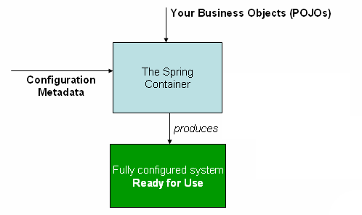
What is Spring
A Java framework that provides comprehensive
infrastructure support for developing Java applications
Manages dependencies and avoid tight coupling
Reduces boilerplate code
Flexible configuration
Other framework support
The Spring IoC container

Slide 5
Spring container
Spring beans - objects that are managed by spring framework
IoC - control of creating and managing dependencies are handed over to spring from the class which need the dependency
DI – populate the dependency to the needed class
→ Constructor Injection, Setter Injection and Field Injection(only possible in annotation)
Configuration metadata – XML based and annotation-based
ApplicationContext - represents the Spring IoC container and is responsible for instantiating, configuring, and assembling the beans

Slide 6
Spring container initialization
ApplicationContext appCtx = new ClassPathXmlApplicationContext(“app.xml")
AbstractApplicationContext.refresh() → instantiate all the required beans for spring, eg: BeanPostProcessors implementation and load configuration metadata
DefaultListableBeanFactory.preInstantiateSingletons → iterate each bean from configuration metadata and trigger initialization of all non-lazy singleton beans
AbstractBeanFactory.getBean → Runtime request for a bean also will come here, and call doGetBean
AbstractBeanFactory.doGetBean → check for scope, if singleton, look bean in a concurrentHashMap. If found, return else continue
AbstractAutowireCapableBeanFactory.createBeanInstance → if the bean has constructor argument of another bean, invoke getBean method for the argument bean, and this loop will continue until the constructor bean gets resolved; else create the bean instance (bean creation + DI via constructor).
AbstractAutowireCapableBeanFactory.populateBean → if the bean has property of another bean, invoke getBean method for the property bean, and this loop will continue until the property bean gets resolved; else populate other properties (bean creation + DI via setter methods or DI on fields).

Slide 7
Autowiring
The Spring container can autowire relationships between collaborating beans
Types
byName - Autowiring by property name, Spring looks for a bean with the same name as the property that needs to be autowired. Using setter methods
byType - Allows a property to be autowired if exactly one bean of the property type exists in the container. Using setter methods
Constructor – Same as byType, but applies to constructor arguments. Using constructor
@Autowired
Annotation can be used on constructor, setter methods and fields to autowire dependencies.
Annotation injection is performed before XML injection; latter configuration will override the properties wired through both approaches

Slide 8
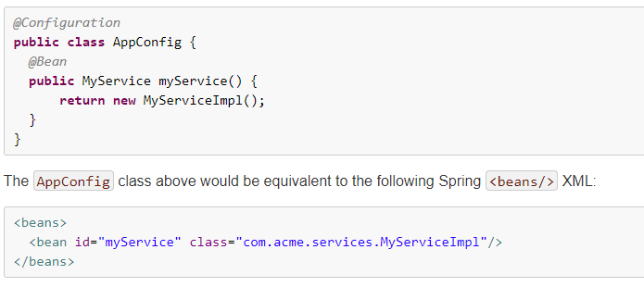
Annotations
What are the beans Spring will look for?
@Component, @Controller, @Service, @Repository and @Bean methods
What are the dependencies?
@Autowired
Where to search for Beans?
@ComponentScan or @Configuration
@Bean annotation plays the same role as the <bean/> element in xml

Slide 9
Spring MVC
The Spring MVC framework is designed around a DispatcherServlet that dispatches requests to handlers, with configurable handler mappings, view resolution, locale and theme resolution as well as support for uploading files
Web application can have root application context and each dispatcher servlet can have its own child context
Root context can be initialized using spring ContextLoaderListener configuration in Web.xml
Upon initialization of a DispatcherServlet, Spring MVC looks for a file named [servlet-name]-servlet.xml in the WEB-INF directory of your web application and creates the beans defined there, overriding the definitions of any beans defined with the same name in the root context

Slide 10
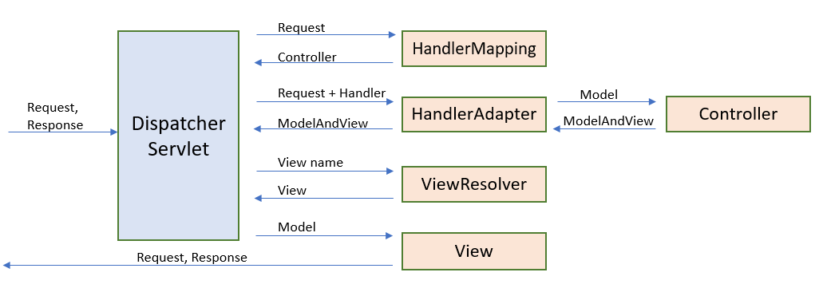
Dispatcher Servlet
HandlerMapping – find the Controller for the URL
HandlerAdapter – invoke the Controller Method and return ModelAndView
Controller – processes the request, invoke business logics, get the Model and return ModelAndView
ViewResolver – create a View for the URL
View – populate Model map to request object attributes and using request dispatcher forward the request

Slide 11
Annotations
What are the beans handler will look for?
@Controller
How handler map the URL?
@RequestMapping
How to map UI form values to our bean and get in the request mapping method?
@ModelAttribute
How to set some values in Model object and get in all the Controller and views
@ControllerAdvice + @ModelAttribute

Slide 12
Spring Boot
Spring Boot makes it easy to create stand-alone, production-grade Spring-based Applications that you can run
Without Spring boot:
Lot of Spring configuration, dependency management, web server setup, boilerplate code, etc.
With Spring boot:
  Provide Auto configuration, dependency management, reduce boilerplate code, embedded web server, no need of deployment descriptor, no need of XML configuration, reduces development time, etc.
  Spring boot starter projects:
  Set of convenient dependency descriptors that you can include in your application and will get the Spring and related technology we needed
  Eg: spring-boot-starter-parent is a special starter that provides useful Maven defaults. It also provides a dependency-management section so that you can omit version tags
spring-boot-starter-web starter pulls all the dependencies related to web development

Slide 13
Auto configuration
@EnableAutoConfiguration
Tell Spring Boot to “guess” how you want to configure Spring, based on the jar dependencies that you have added
How to get the @Configuration classes for auto-configuration
  Classes listed in the key org.springframework.boot.autoconfigure.EnableAutoConfiguration from META-INF/spring.factories
  Note: starter projects are not using @ComponetScan to look for @Configuration classes, also not provide any configuration class as application context constructor argument
Where to search for beans
@Configuration classes
Criteria for bean creation through auto-configuration
@ConditionalOnBean, @ConditionalOnMissingBean, etc

